Slide 1
Exercise 7 TRASVERSE-FIELD ISING MODEL
QUANTUM INFORMATION AND COMPUTING course 2021/2022
Alessandro marcomini (2024286)
Prof. Simone montangero

Slide 2

Exercise goals
Consider N spin-$1/2$ particles on a one-dimensional lattice, described by the Hamiltonian
$H= λ\sum_{i}^{N}{σ_{z}^{i}}$ - $\sum_{i}^{N−1}{σ_{X}^{i}}$ $σ_{X}^{i+1}$
where σ’s are the Pauli matrices and λ is the interaction strength.
Write a program that computes the $2^{N}$ × $2^{N}$ matrix representation of the Hamiltonian H for different N
Diagonalize H for different N = 1, ... , $N_{max}$ and λ ∈ [0 : 3]. How big is $N_{max}$ you can reach?
Plot the first k levels as a function of λ for different N. Comment the spectrum.

Slide 3

IN THEORY…
System subject to quantum fluctuations: at critical point we face quantum phase transition (analytical solutions possible)
For $λ=0$: minimum energy if all spins aligned (in X), if $λ≫1$: first term dominates and minimal energy for all spins along Z
To enhance programming, recall that $1_{m} ⨂$ $1_{n}=1_{nm}$
Enlarging system size is hard: H scales exponentially with N

Slide 4
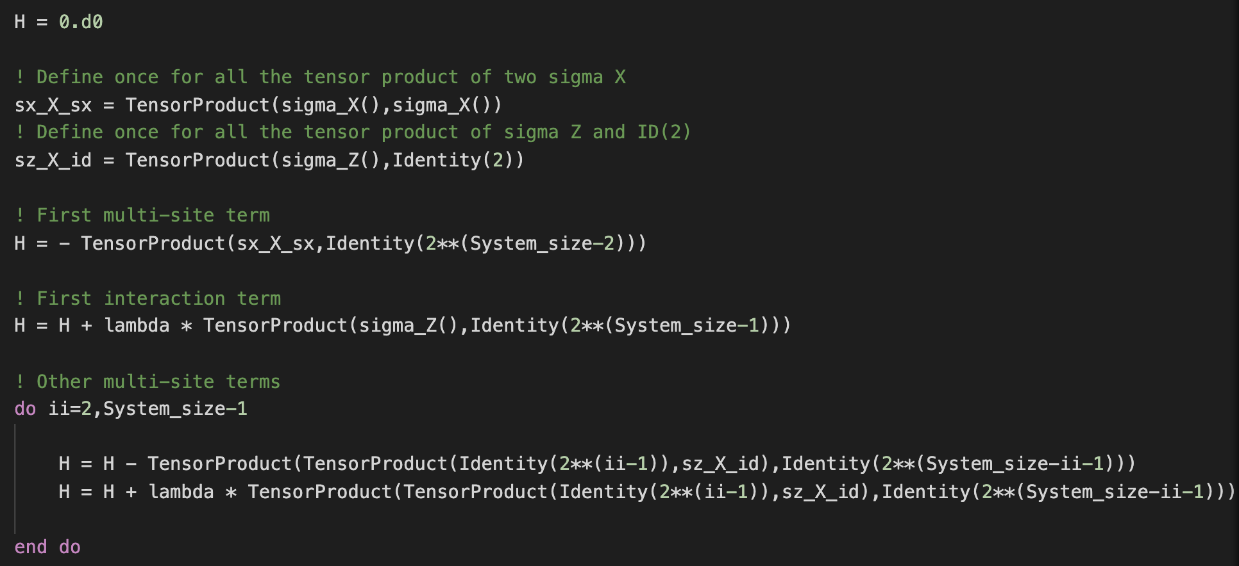
CODE DEVELOPMENT:
Diagonalization via ZHEEV (LAPACK)
Computational time bearable (O(s)) up to N = 12
For N = 13, time = O(min); N = 16 implies memory error
TFI generator

Slide 5


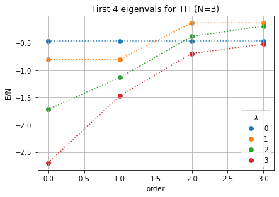
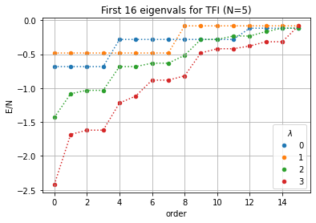
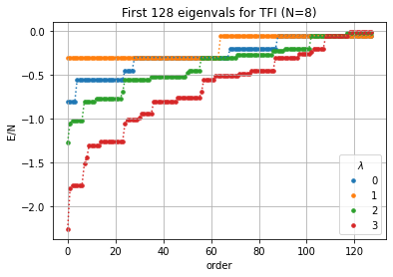
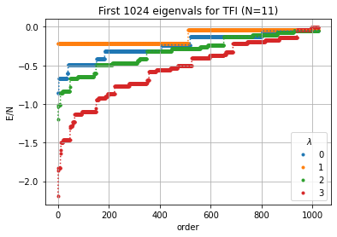


SPECTRA FOR DIFFERENT N, $λ$:
Large degeneracy for smaller $λ$ values
Spectrum is symmetric in energy
Larger $λ$ allows to reach lower energy per spin
Neat jump in energy for $λ$=1: first $2^{N−2}$ eigenvals are in degenerate ground state, then $2^{N−2}$ degenerate in an higher energy state (no similar trends for other values of $λ$).

Slide 6









Numerical Ground state eigenvectors (N=3):
$$|ψ> =$$
$$0.493∙(|000> + \left|111>\right)+$$
$$0.085∙(|001> + \left|110>\right)+$$
$$0.085∙(|010> + \left|101>\right)+$$
$$0.493∙(|011> + \left|100>\right)$$
$$|ψ> = 0.354 ∙\sum_{i=0}^{7}{|i>}$$
$$λ=0$$
$$λ=1$$
$$|ψ> =$$
$$0.577∙(|000> + \left|111>\right)+$$
$$0.382 ∙(|001> + \left|110>\right)+$$
$$0.130 ∙(|010> + \left|101>\right)+$$
$$0.065 ∙(|011> + \left|100>\right)$$
$$|ψ> =$$
$$0.597∙(|000> + \left|111>\right)+$$
$$0.325 ∙(|001> + \left|110>\right)+$$
$$0.155 ∙(|010> + \left|101>\right)+$$
$$0.117 ∙(|011> + \left|100>\right)$$
$$λ=2$$
$$λ=3$$
F$or λ=0$ the behaviour is greatly different from others, but a general symmetry is respected for all
Runs (in particular, amplitude probabilities are not affected by global bit flips). For large $λ$ changes in the
absolut value of coeffs is minimal.

